Slide 1
CWE/CAPEC User Experience Working Group Meeting
August 24, 2022

Slide 2
Agenda
Housekeeping
Primary topics
Definitions! (continued…)
Why are we doing this? The questions we asked ourselves…
Distillation of the many responses we received
Present newly proposed definitions
Personas and Presentation Filters
Reminders and Adjourn
This meeting is being recorded :-)

Slide 3
UEWG: Reminders
Mission: Identifying areas where CWE/CAPEC content, rules, guidelines, and best practices must improve to better support stakeholder community, and work collaboratively to fix them
Periodic reporting of activities to CWE/CAPEC Board
(next quarterly Board meeting TBD Sept/Oct)
Please solicit participations from your contacts
Contact: cwe@mitre.org & capec@mitre.org

Slide 4
Housekeeping
We are working to identify ongoing opportunities and priorities for FY23
(Underway) Collaborative CWE/CAPEC content development space collaboration space
Provide users technical reach back
Socialization strategy
This discussion/action, drive working group activities, etc.

Slide 5
Topic
Definitions! (continued…)
Harmonizing common terms across CWE/CAPEC
Alec Summers – CWE/CAPEC Deputy PL
Shadya Maldonado Rosado – UEWG Co-Chair

Slide 6
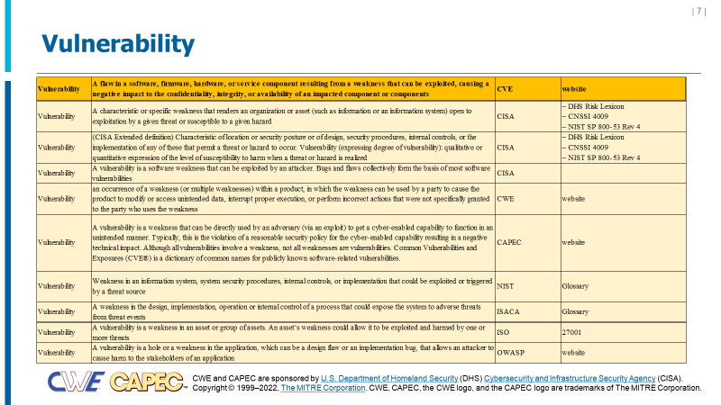
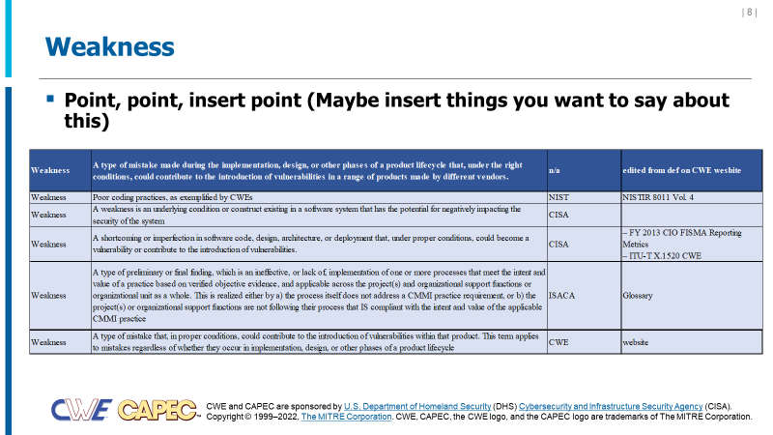
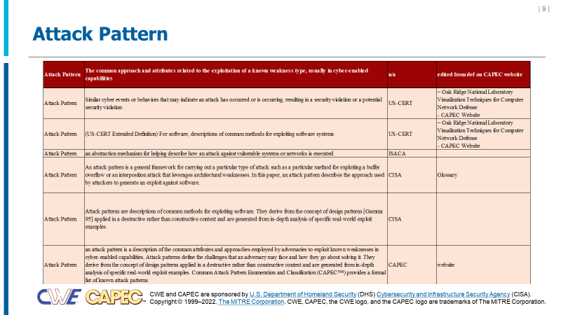
CWE / CAPEC Terminology
Authoritative sources define terms differently
Vulnerability is defined three different ways between CVE, CWE, and CAPEC ☹
Vulnerability, Weakness, and Attack Patterns have multiple definitions across CISA, NIST, ISO Standards, etc.

Slide 7
Early Thought Process
The questions we asked ourselves…
What problem are we trying to solve?
Are circular definitions problematic or important?
Can we accommodate with the CVE ‘vulnerability’ definition without changes?
Other thoughts
Steve’s ‘APES’ Test (i.e., ‘aspirin’, physical, extension cord, spelling)

Slide 8
Compilation of Feedback (1 of 2)
Feedback providers agreed to delete "... in a range of products made by different vendors”
Follow CVE vulnerability definition format/style
Using the term “flaw” may create a circular definition
Leverage the term “condition” instead of “defect”
May or may not be exploitable
Notes:
The key is that a weakness is a condition; it may include human and process flaws. A weakness begins or contribute to that chain of circumstances that results in a vulnerability/harm.
We can define vulnerabilities as a specific subset of weaknesses.
It is the existence of an exploit designed to take advantage of a weakness (or multiple weaknesses) and achieve a negative technical impact that makes a weakness a vulnerability.

Slide 9
Compilation of Feedback (2 of 2)
Vulnerability = one or more weaknesses + known exploit
vulnerability weakness(es) that can be exploited as part of an attack path
weakness Condition that can lead to undesirable behavior
A condition that under the right circumstances begins a process or combines with other weaknesses to cause a harm in a product or system
Under the right conditions, could lead to undesirable behavior

Slide 10
Sample Proposed Definitions
Original Proposed definition for Weakness:
A type of flaw or defect inserted during a product lifecycle that, under the right conditions, could contribute to the introduction of vulnerabilities in a range of products made by different vendors
A condition that under the right circumstances begins a process or combines with other weaknesses to cause a harm in a product or system
A condition or mistake made during the implementation, design, or other phases of a product lifecycle could contribute to the introduction of exploitable elements
A type of flaw or defect inserted during a product lifecycle that, under the right conditions, could lead to undesirable behavior
A type of flaw or defect inserted {or inadvertently developed} during a product lifecycle that, under the right conditions, could contribute to the introduction of vulnerabilities
A condition created or introduced during a product lifecycle that, under the right conditions, could lead to undesirable behavior

Slide 11


Definitions: Take Two
Term | Definition | Authority | Authorities Doc
Vulnerability | A flaw in a software, firmware, hardware, or service component resulting from a weakness that can be exploited, causing a negative impact to the confidentiality, integrity, or availability of an impacted component or components | CVE | website
Weakness | A condition in a software, firmware, hardware, or service component that, under the right circumstances, could contribute to the introduction of vulnerabilities | n/a | edited from def on CWE website
Attack Pattern | The common approach and attributes related to the exploitation of a weakness, usually in cyber-enabled capabilities | n/a | edited from def on CAPEC website

Slide 12
Topic 2
User Personas and CWE/CAPEC Presentation Filters
Alec Summers
CWE/CAPEC Deputy PL
CWE/CAPEC minor releases coming in late Sept / early Oct

Slide 13
Personas: Finalizing
Formally define each user persona
Share with CWE/CAPEC Board
Once finalized, make public on our sites
Use that as a catalyst for modernizing presentation according to persona needs
“Development lifecycle”
Those who build, use, and protect infrastructure around information systems
Educators: Teachers, professors, or certification programs that educate developers and system designers how to develop more secure code, design more secure products, and/or how to find vulnerabilities.
Technical Writers: Those who communicate advanced technical concepts as clearly, accurately, and comprehensively as possible to their intended audience (e.g., code analysis tool users or system designers)
Tool Developers: Developers of code scanning products, services, and other types of automated techniques for finding weaknesses and attacking systems, and reporting/educating on findings to users
Security Researchers/Analysts: Those who look for ways to attack a product by finding weaknesses using manual and/or automated techniques, then reporting the findings to the vendor and/or the general public (to include threat modeling, C-SCRM)
Incident Response Teams: Those responsible for preparation and reaction to any security event ??

Slide 14
Adjusting our Presentation Filters
Better serve our user persona needs
“Two-Types” Proposal by Premyslaw Roguski (Red Hat)
Theoretical: users who are more focused on the theoretical aspects of the weaknesses
Educators (teachers, professors, solution architects who design the systems' requirements)
Technical Writers (people responsible for security content, security blogs and articles)
Project and Program Managers who need some level of understanding about security and weaknesses
Technical: users who are managing the security issues and need more details about the nature of the weakness and how to prevent this from happening
Tool Developers, Security Researchers, Pentesters, Incident Response Analysts

Slide 15
Proposed Data Elements for Each Group
Theoretical:
Description, Extended Description, Alternate Terms, Common Consequences
Technical (operational?):
Description, Extended Description, Alternate Terms, Modes of Introduction, Demonstrative Examples, Observed Examples (include recent CVE tracking data*), Potential Mitigations, Relationships
Mapping-Friendly:
Description, Extended Description, Alternate Terms, Modes of Introduction, Likelihood of Exploitation, Taxonomy Mappings, Memberships, Notes
Complete:
all

Slide 16
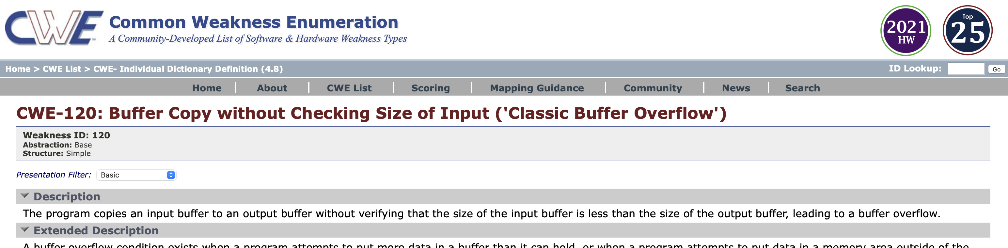
Discussion: How best to Improve Awareness/Utility?
theoretical
Do people know it’s there on each entry?
Where else could we draw attention to it (e.g., landing page, how-to/guidance material?)

Slide 17
Next Meeting – September 21 @ 12pm
PLEASE CONTACT WITH ANY QUESTIONS OR THOUGHTS
CWE@MITRE.ORG
CAPEC@MITRE.ORG

Slide 18
Use Case Scenarios → Content Presentation
CAPEC Existing functionality to filter content detail
Basic, High-level, Mapping-friendly, Complete
CWE Content Filter
BASIC | HIGH-LEVEL | MAPPING | COMPLETE
Description | Description | Description | Description
Applicable_Platforms | View_Audience | View_Audience | View_Audience
Common_Consequences | Alternate_Terms | Alternate_Terms | Alternate_Terms
Likelihood_of_Exploit | Time_of_Introduction | Terminology_Notes | Terminology_Notes
Demonstrative_Examples | Common_Consequences | Relationships | Applicable_Platforms
Potential_Mitigations | Relationships | Relationship_Notes | Modes_of_Introduction
Relationships | Content_History | Theoretical_Notes | Common_Consequences
Content_History |  | Related_Attack_Patterns | Likelihood_of_Exploit
 |  | Content_History | Enabling_Factors_for_Exploitation
 |  |  | Detection_Methods
and more…

Slide 19
Use Case Scenarios → Content Presentation
CAPEC Existing functionality to filter content detail
Basic, Complete
CAPEC CONTENT
BASIC | COMPLETE
Description | Description
Relationships | Relationships
Memberships | Memberships
Execution_Flow | Execution_Flow
Prerequisites | Prerequisites
Mitigations | Mitigations
Related_Weaknesses | Likelihood_Of_Attack
 | Alternate_Terms
 | Typical_Severity
 | Skills_Required
 | Resources_Required
 | Indicators
 | Consequences
 | Example_Instances
 | Related_Weaknesses
 | Taxonomy_Mappings
 | References
 | Notes
 | Content_History

